Slide 1

JP Morgan Chase Financial AI Agent
From wait-times to real-time – an OpenAI-powered customer experience.

Slide 2

Table Of Contents
01. Introduction of AI Financial Agent
02. Analysis / Finding Results
03. Impactful Recommendations
04. Conclusion of AI Financial Agent

Slide 3

Introduction
AI-driven customer service assistant for banking.
Supports balance, transactions, savings, and document uploads.
Delivers real-time, personalized financial support using OpenAI.

Slide 4
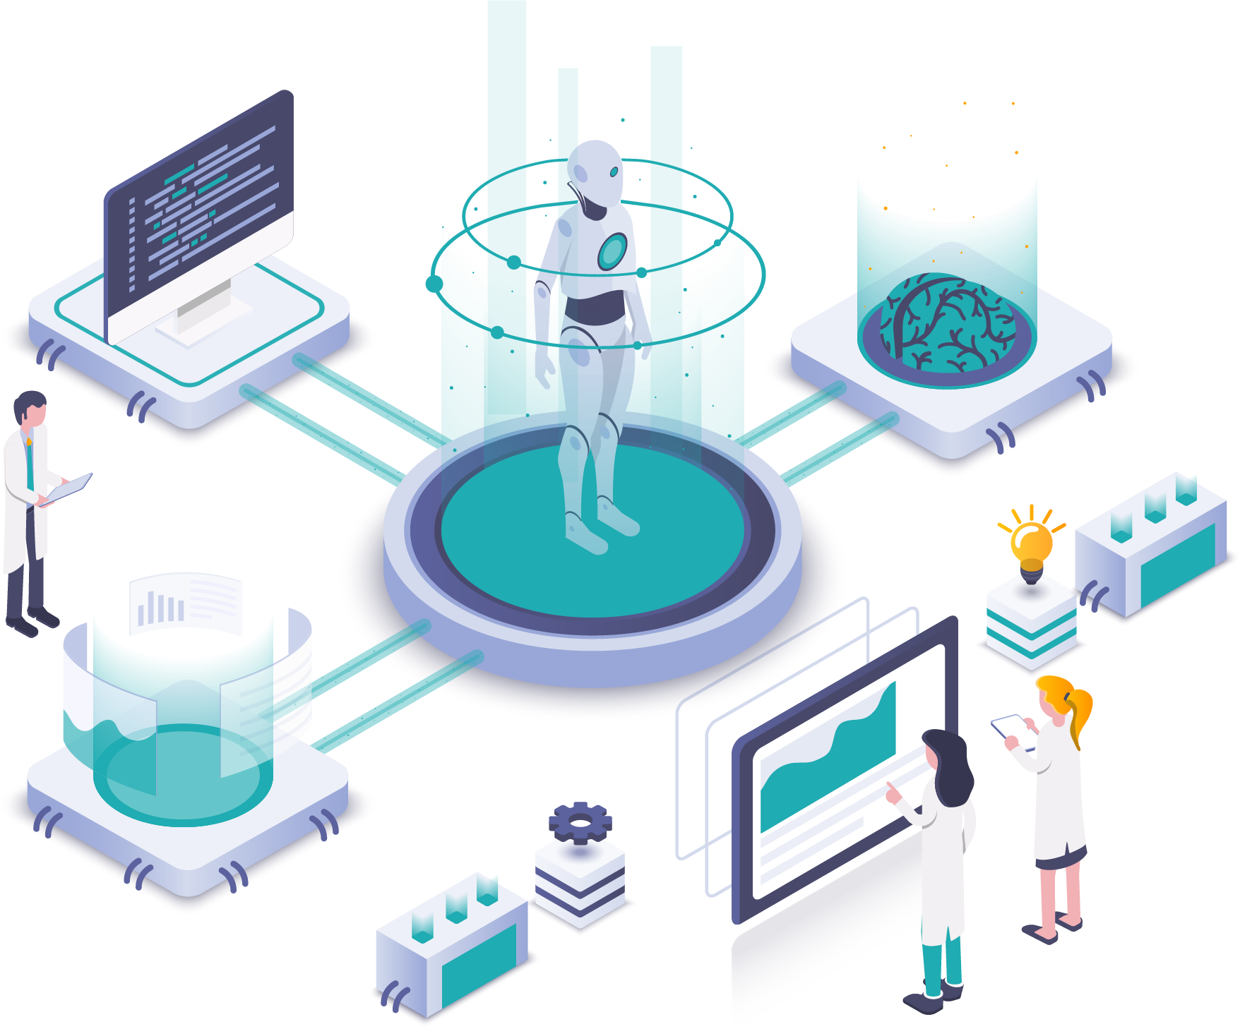
Problem Statement
Long customer wait times and limited real-time service.
Lack of personalized financial guidance.
No support for uploading and analyzing financial documents.
Poor customer experience impacting retention and costs.

Slide 5

Our AI Solution
Built an AI Financial Assistant using OpenAI GPT models and Gradio.
Supports balance checks, transaction history, savings guidance, and financial document analysis.
Personalized for existing customers and onboarding new users.
Instant, efficient, 24/7 digital service without human wait times.

Slide 6
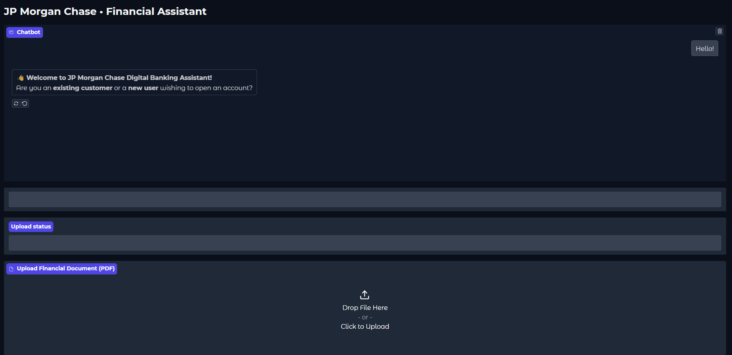

Slide 7
Technical Architecture
1
Frontend: Gradio Chat Interface for user interactions.
Backend: OpenAI GPT-3.5 Turbo powers the conversation and document analysis.
2
3
Database: SQLite to verify existing customers (Phone, ZIP, Balance, Transactions).
File Handling: PDFplumber extracts text from financial documents for AI analysis.
4
5
Hosting: Can be deployed easily on cloud (AWS, Azure, etc.).

Slide 8

Analysis & Key Insights
By providing seamless and personalized interactions, AI Chatbots enhance user experience, making interactions more efficient and satisfying.

Slide 9
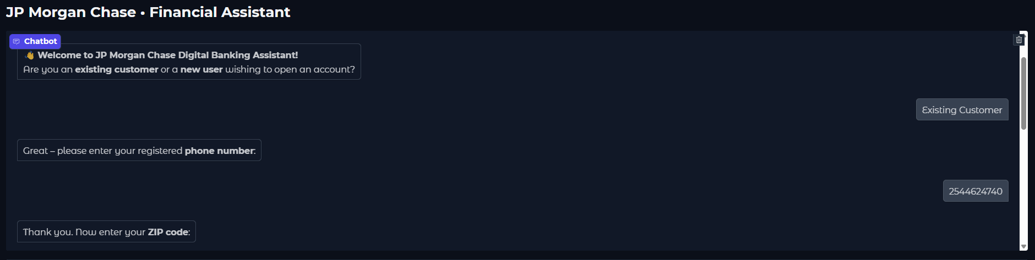
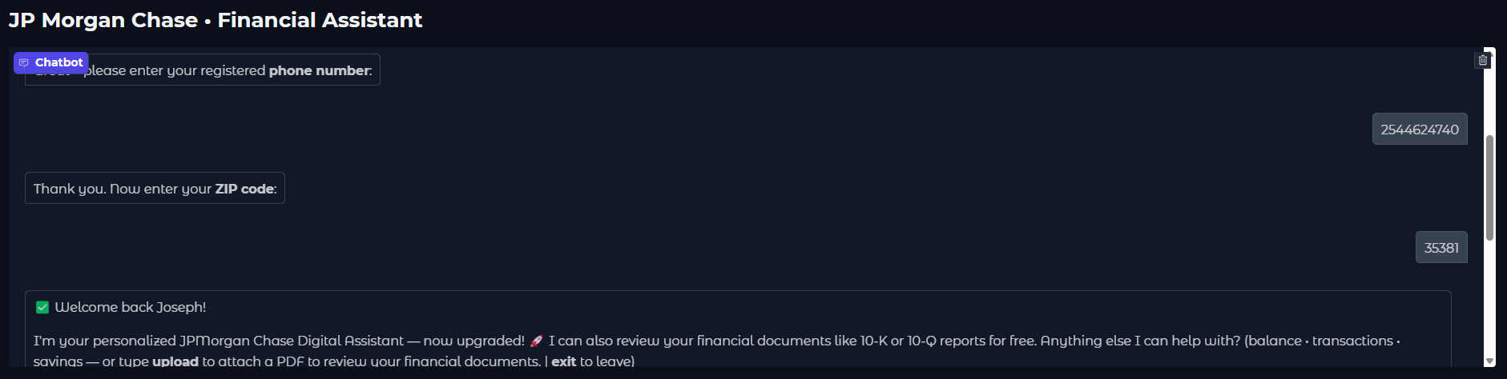

Slide 10
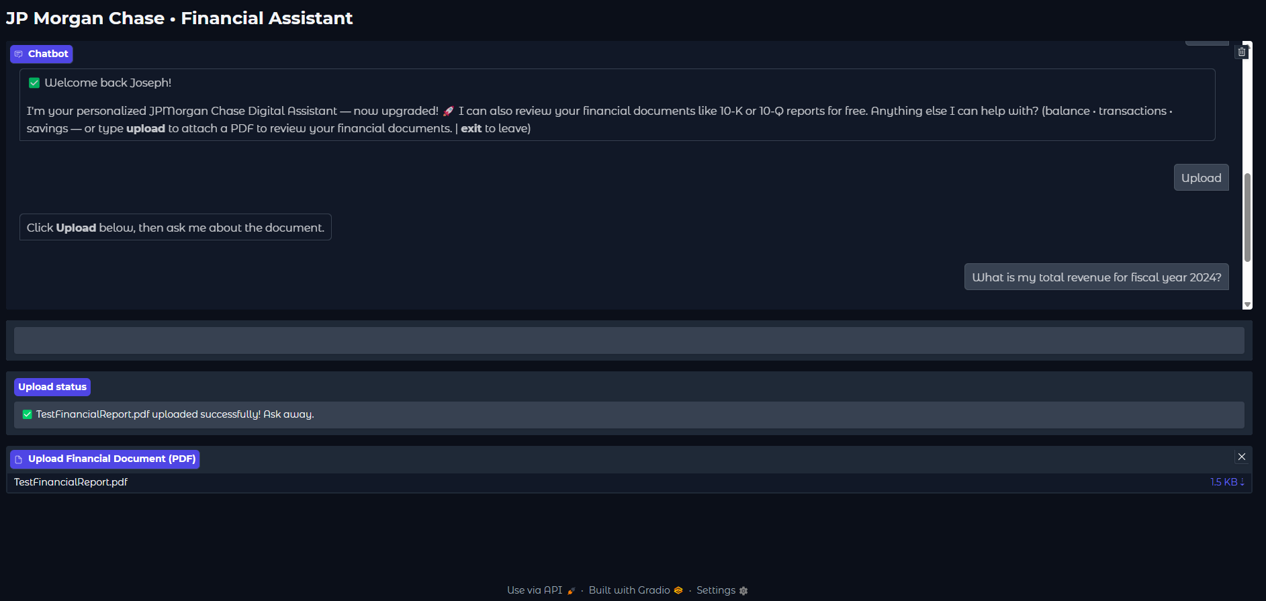

Slide 11
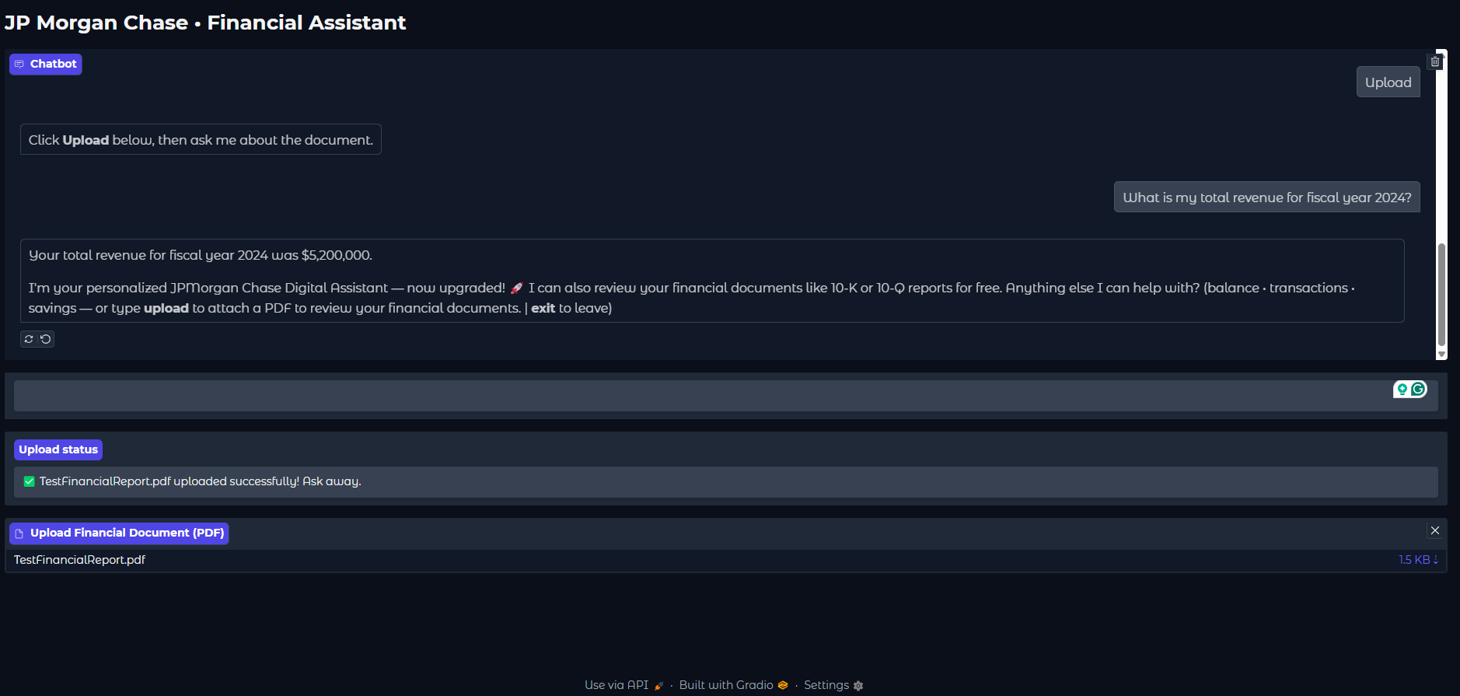

Slide 12
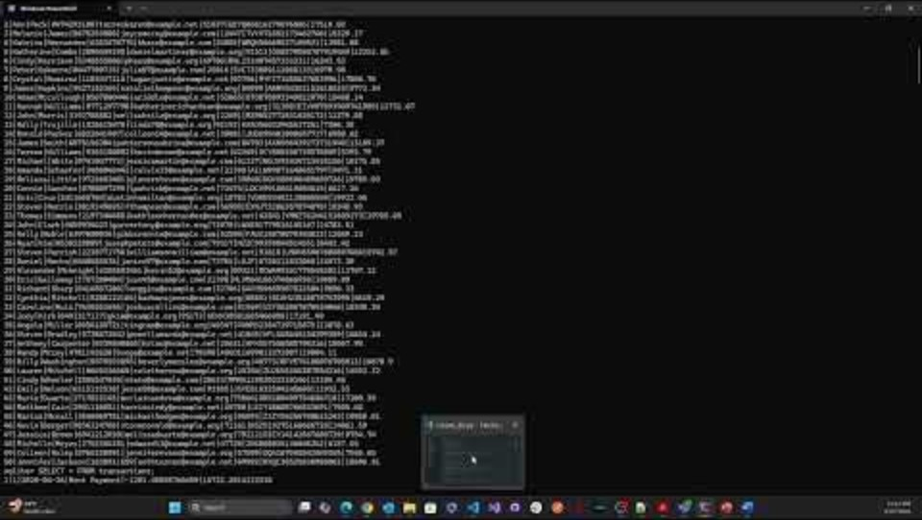

Slide 13

Impactful Recommendations
Automate First-Line Support: Use AI agent for answering balance, transactions, savings, and product inquiries 24/7.
Enhance Personalization: Recognize existing customers to offer faster services.
Boost Operational Efficiency: Reduce wait-times by automating document analysis (PDF upload and Q&A).
Future Integration: Connect the chatbot with real-time banking APIs for even more personalized and live support.

Slide 14

Strategic Business Improvements
Self-Service Tools: AI-driven planning for savings, loans, and investments.
Document Insights: Upload 10-K/10-Q for instant analysis.
Smart Recommendations: Personalized Chase offers based on user behavior.
Adaptive AI: Ongoing learning to boost accuracy and loyalty.

Slide 15

Conclusion
In conclusion, AI Chatbots revolutionize customer service, enhance user experiences, and drive operational efficiency, empowering businesses to thrive.

Slide 16
"AI is like a canvas, and human creativity is the paintbrush that brings it to life."

Slide 17

Thank You!
Presented by: Mohammed Zakiuddin
Texas A&M University-Commerce
Hackathon Event – Business Analytics 2025

